Slide 1


Sales Dataset Analysis- Advanced Excel Project
Presentation By
AKILAN J
Date: 12/12/2024 Batch: DADS

Slide 2

PROJECT OVERVIEW C OBJECTIVES
PROJECT OVERVIEW
To Analyze the Given Data
GOALS
Analyze Sales Trends
Determining the Returns and Discount’s Creating Dynamic Dashboard
High Performing products, sales channels

Slide 3

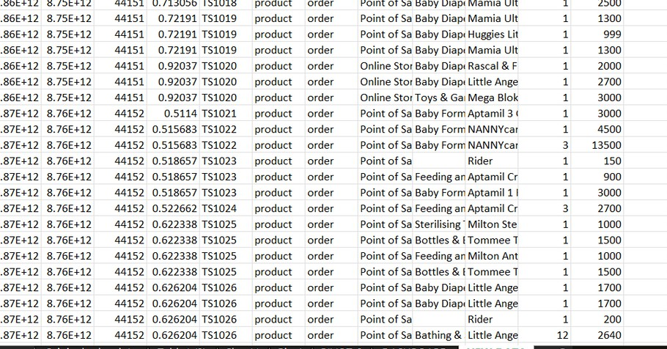
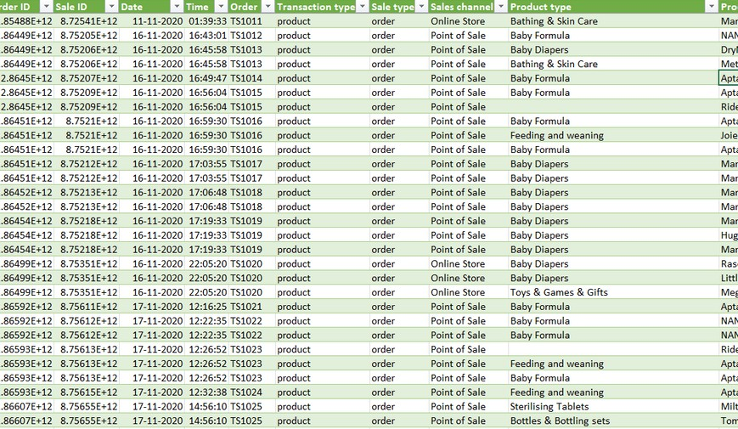
Data Description and Preparation
Dataset Overview:
The Raw Dataset contains 28,756 rows, columns such as Order ID, Sale ID, Product Type
Data Cleaning Process
Removal of blank rows, date and time column has been separated, removal of duplicates
Visuals
BEFORE
AFTER

Slide 4




TOTAL SALES
Key Metrics Calculation and Dat
a Analysis
NET SALES
GROSS SALES

Slide 5

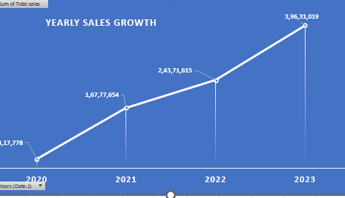
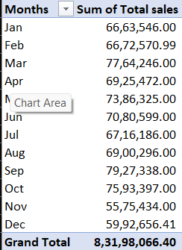
Pivot Tables and Pivot Charts
Pivot Table Summary
Pivot Chart Visualizations
Visuals

Slide 6

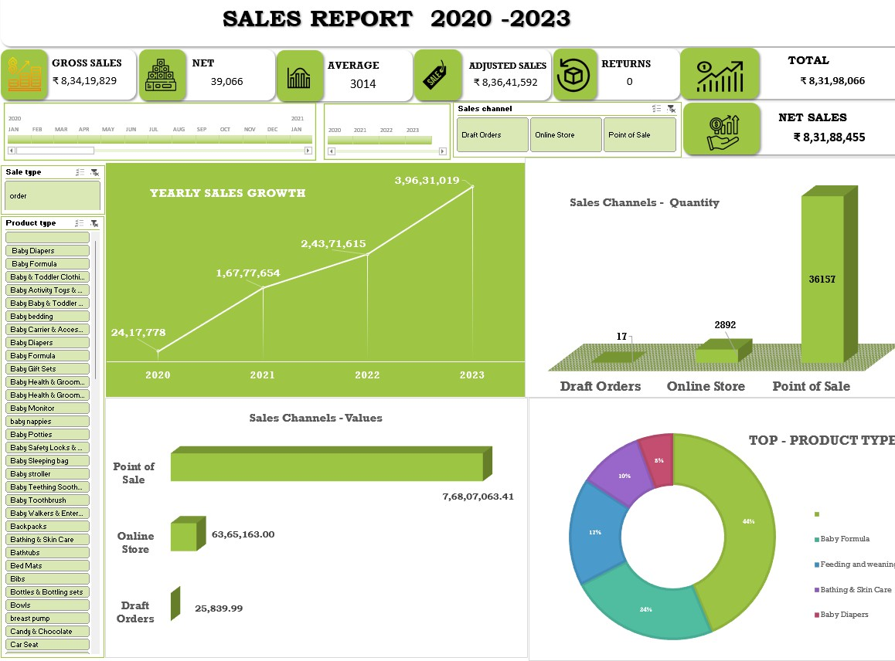
Dashboard Overview

Slide 7
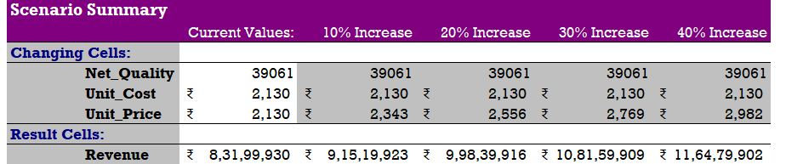
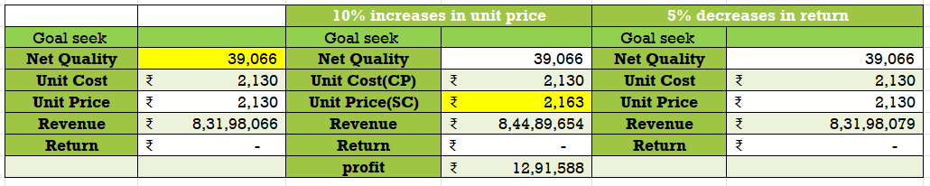

What-If Analysis C Goal Seek
What-If Scenarios
Goal Seek

Slide 8
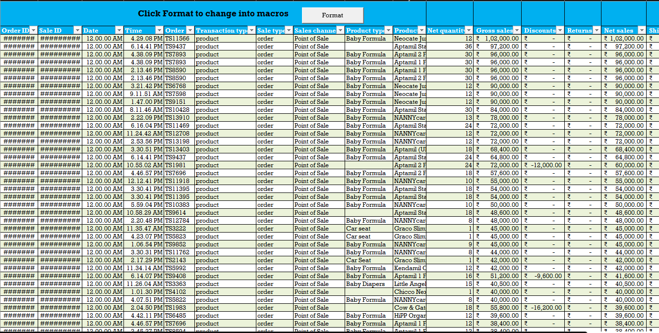
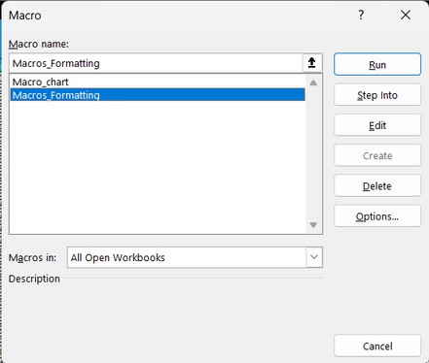

Macros and Automation
Macro Recording : Formatting, Freeze panes, pivotable and pivot charts.
Automation Benefits: Saves time and improved the efficiency of the analysis.

Slide 9

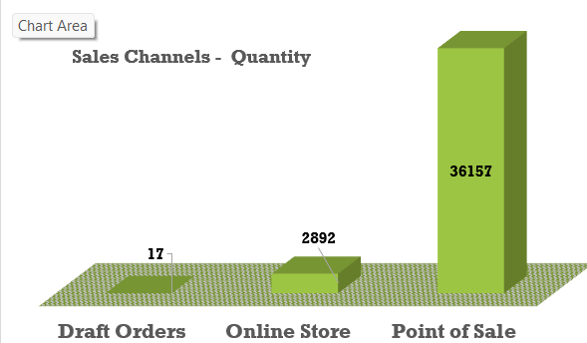
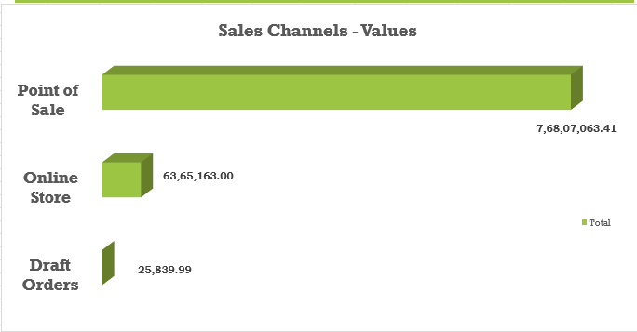
Insights and Recommendations
Key Insights: The most important insights from the analysis, such as:
Best-performing sales channels/products.
Trends in discounting and its impact on total sales.
Seasonal sales variations or peak performance times.
Recommendations for improving sales based on analysis.

Slide 10

Conclusion
Sales Channel: Draft orders < Online Store > Point of sales.
Product Type: In the year 2023
High: Baby Formula
Focus: Baby walkers & Entertainers and laundry bags.
Discounts: Riders & Bus in Product from Others Product type.

Slide 11

Thank You :)

